Slide 1
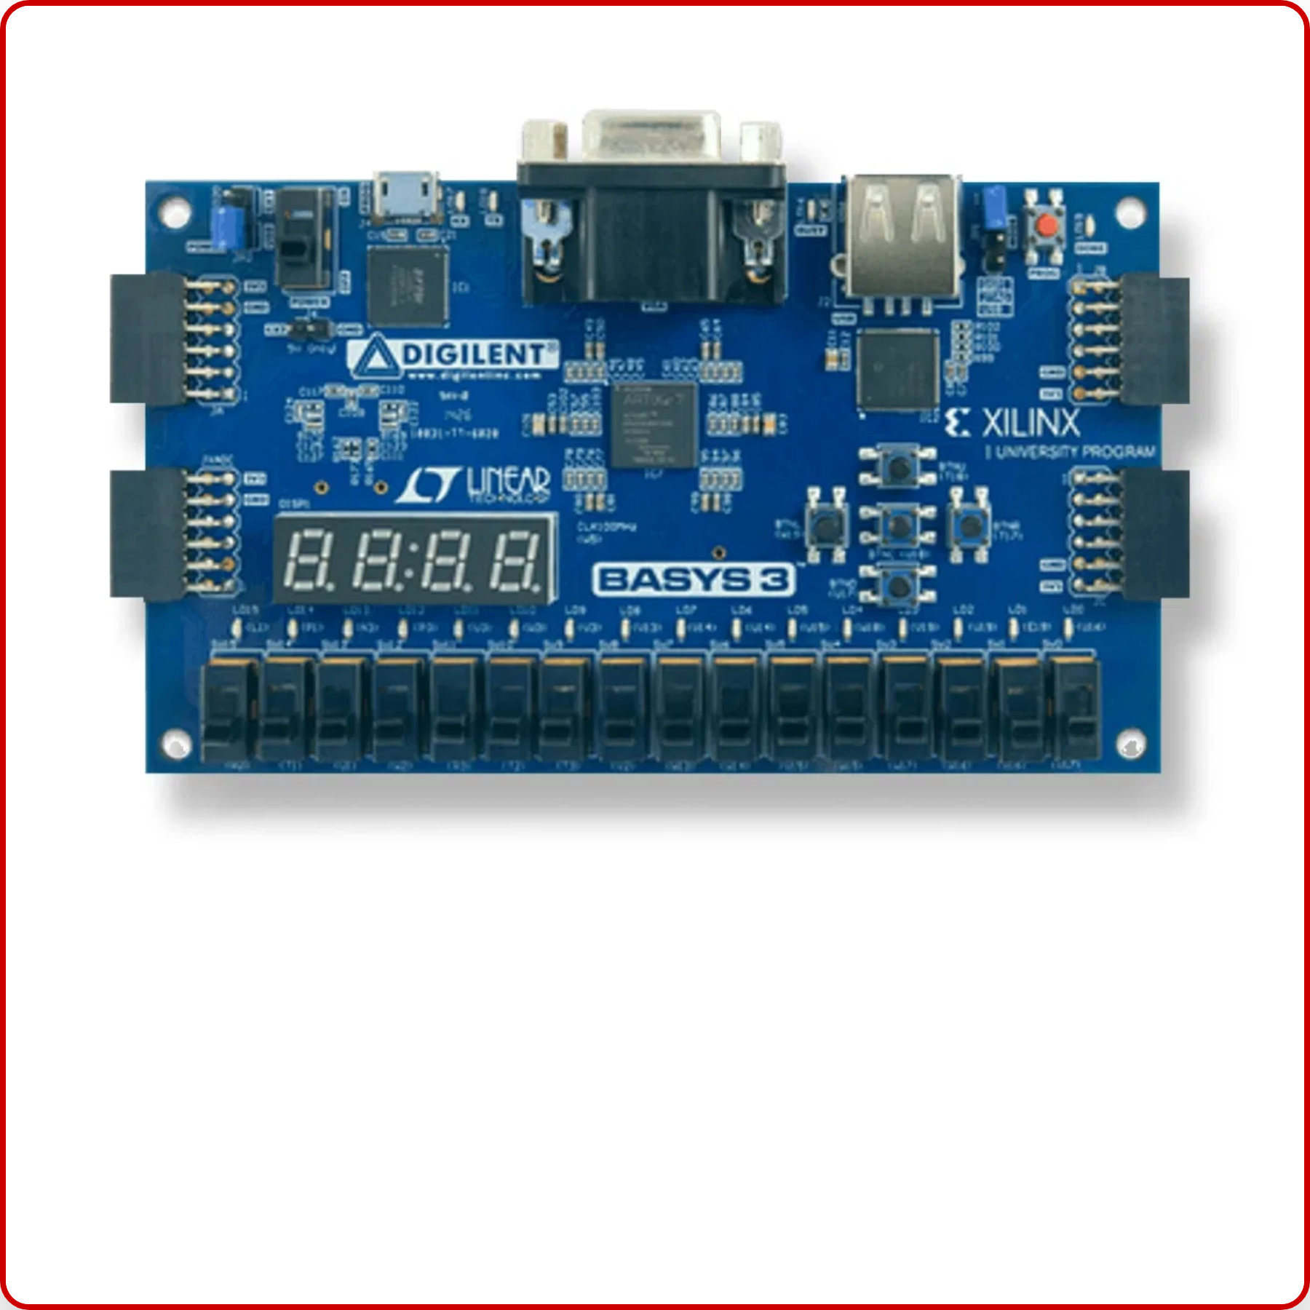
Building an 8-bit CPU from Scratch
why this project and how i did it complete detail
Name : daksh vaishnav
from : indore institute of science and technology
board : artix-7 xc7a35t-cpg236-1 (basys 3)

Slide 2

Table of Contents
1
The
Vision
- Why build a CPU from scratch?
2
Architecture Overview
- Block diagram and key components
3
Verilog Implementation
- Code snippets and design patterns
4
Memory System
- ROM, RAM, and memory mapping
5
Testing & Debugging
- LED and 7-segment interfaces
6
Challenges Overcome
- Technical hurdles and solutions
7
Lessons Learned
- Knowledge gained
8
Future Enhancements
- Next steps and improvements

Slide 3






The Vision
Why build a CPU from scratch?
Building a CPU from scratch provides hands-on experience with fundamental computer architecture concepts and digital design principles that are often abstract in theory. It bridges the gap between hardware and software, offering a deeper understanding of how computers actually work.
Learning Objectives
Computer Architecture:
Understanding CPU components,
datapath, control unit, and instruction execution
Verilog HDL:
Mastering hardware description language
for digital circuit design
FPGA Development:
Working with programmable
hardware and synthesis tools
Digital Design:
Applying principles of digital logic, timing,
and hardware constraints

Slide 4
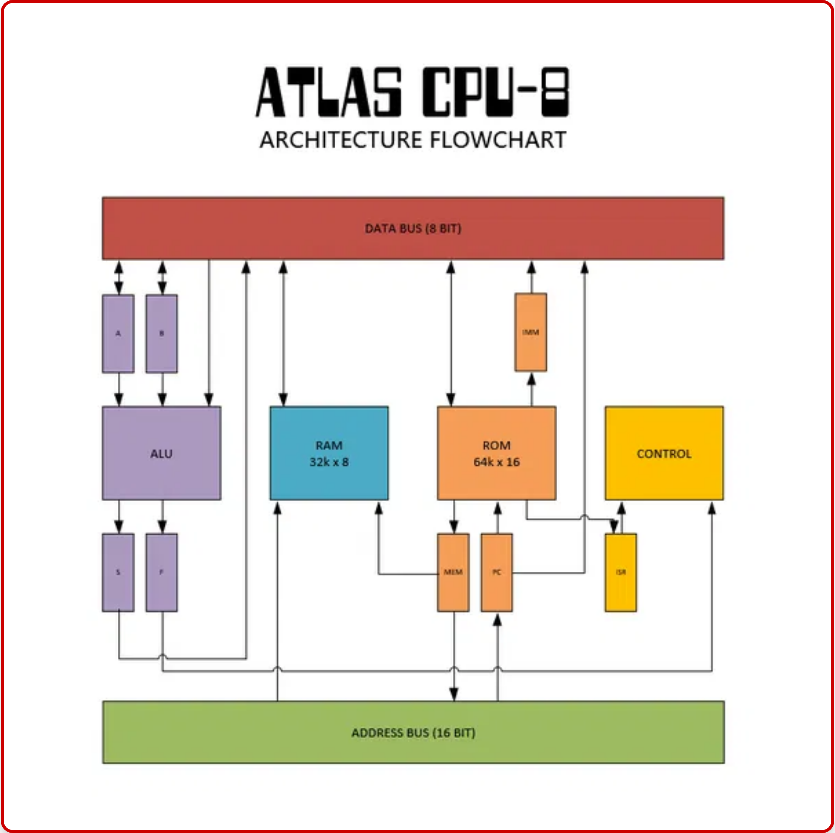




Architecture Overview
The 8-bit CPU architecture follows a classic von Neumann design with separate datapath and control unit components. This modular approach allows for clear separation of concerns and simplified debugging.
Key Components
ALU (Arithmetic Logic Unit):
Performs all arithmetic and logical
operations, including addition, subtraction, AND, OR, and XOR.
Registers:
Fast storage for operands and results. Includes
general-purpose registers and special registers like the Program
Counter (PC) and Instruction Register (IR).
Memory Interface:
Connects the CPU to program ROM and data
RAM, handling address decoding and data transfer.
Control Unit:
Orchestrates the operation of all components
based on the current instruction, generating control signals for
the datapath.
Execution Flow
Instructions are fetched from memory, decoded by the control unit, and executed throug`h the datapath. The datapath routes data between registers, memory, and the ALU according to control signals.

Slide 5

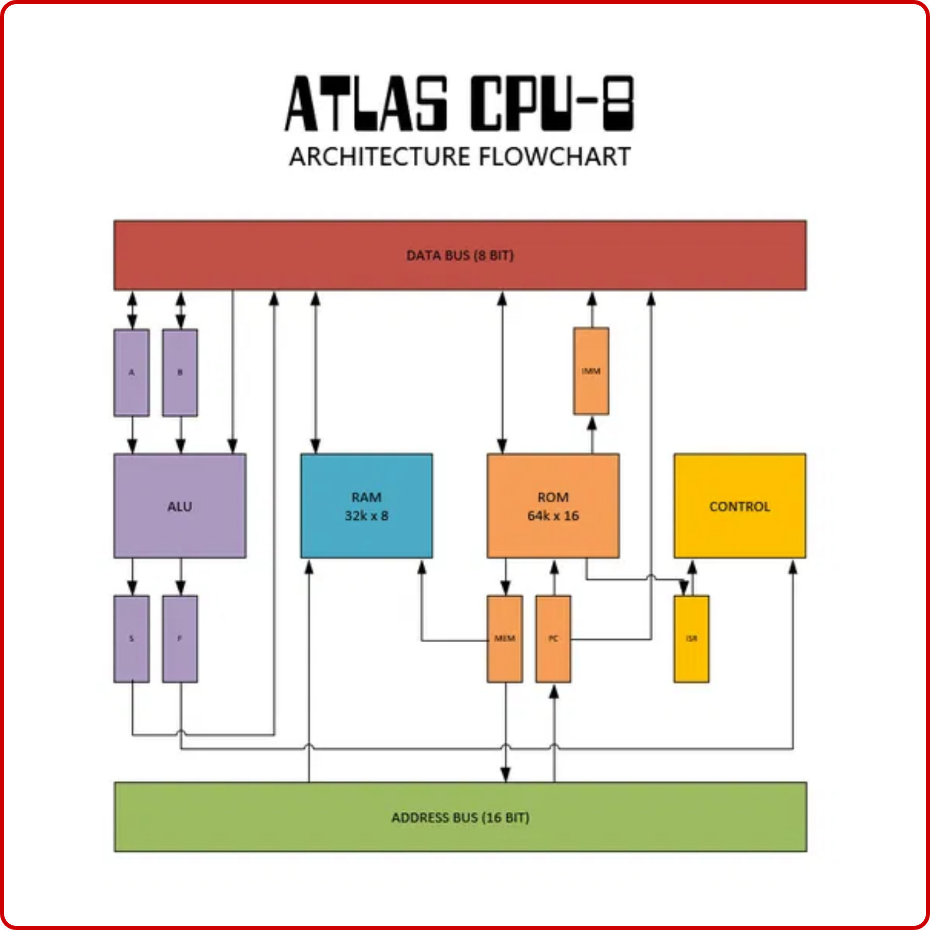



Instruction Set Architecture
16 Instructions Table
Opcode Format
Opcode (Hex)
Instruction
Description
4-bit Opcode
4-bit Operand
0x0
NOP
No operation
Each instruction is 8 bits wide, with the upper 4 bits representing the operation code (opcode) and the lower 4 bits representing the operand or address.
0x1
ADD
Add register to accumulator
0x2
SUB
Subtract register from accumulator
0x3
AND
Logical AND with accumulator
0x4
OR
Logical OR with accumulator
0x5
XOR
Logical XOR with accumulator
0x6
LOAD
Load from memory to accumulator
0x7
STORE
Store accumulator to memory
0x8
JMP
Jump to address
0x9
JZ
Jump if zero
0xA
JNZ
Jump if not zero
Instruction Examples
ADD R2
: 0x12 - Add value in register 2 to accumulator
LOAD 0x5
: 0x65 - Load value from memory address 5 to
accumulator
JMP 0xF
: 0x8F - Jump to address 0xF in program memory

Slide 6
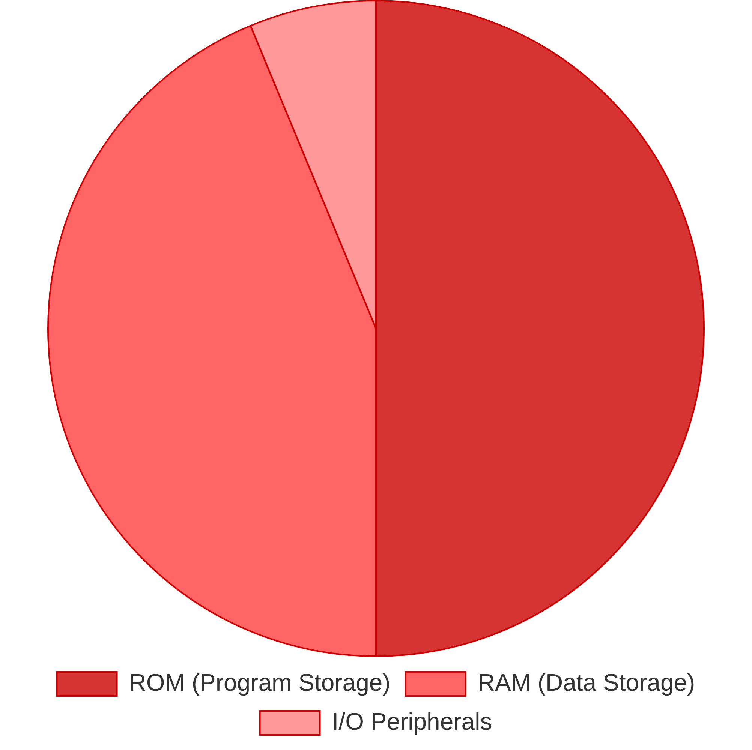





Memory System
ROM for Program Storage
Non-volatile storage
for instruction code, preserving the
program even when power is off
Stores 8-bit instructions in
4-bit opcode + 4-bit operand
format
RAM for Data Storage
Volatile storage
for runtime data, variables, and computation
results
Supports both
read and write operations
during program
execution
Memory Mapping Strategy
Address space partitioning:
Lower addresses (0x00-0x7F) for
program ROM, higher addresses (0x80-0xEF) for data RAM
Memory-mapped I/O:
Highest addresses (0xF0-0xFF) reserved for
peripherals like LEDs and 7-segment displays
Direct addressing
for efficient memory access with 4-bit address
field in instructions

Slide 7
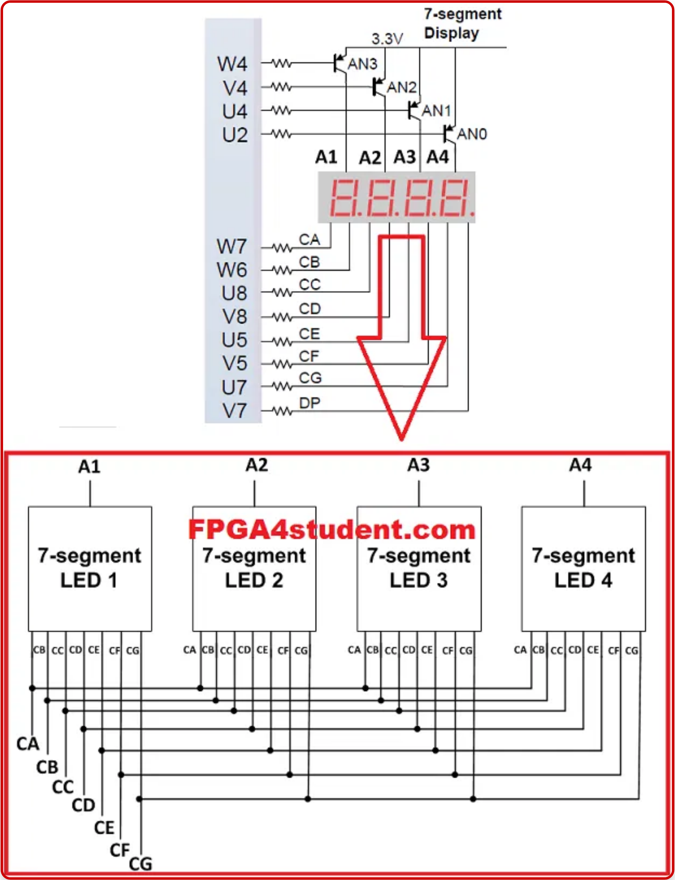





Testing & Debugging
Debugging Interface
LED Array:
Used to display register values, ALU operations, and
current state of the CPU
7-Segment Display:
Shows memory addresses, data values, and
calculation results
Counting Sequence
1
2
3
4
5
6
7
8
9
A
B
...
The counting sequence verified proper program execution and memory access, confirming the CPU's ability to increment values and display them correctly.
Verification Methods
Step-by-Step Execution:
Manually stepping through instructions
to verify each operation
Test Programs:
Simple programs to test arithmetic, jumps, and
memory operations
Calculation Test:
verify ALU functionality
Successfully performed 10 + 5 = 15 calculation to

Slide 8


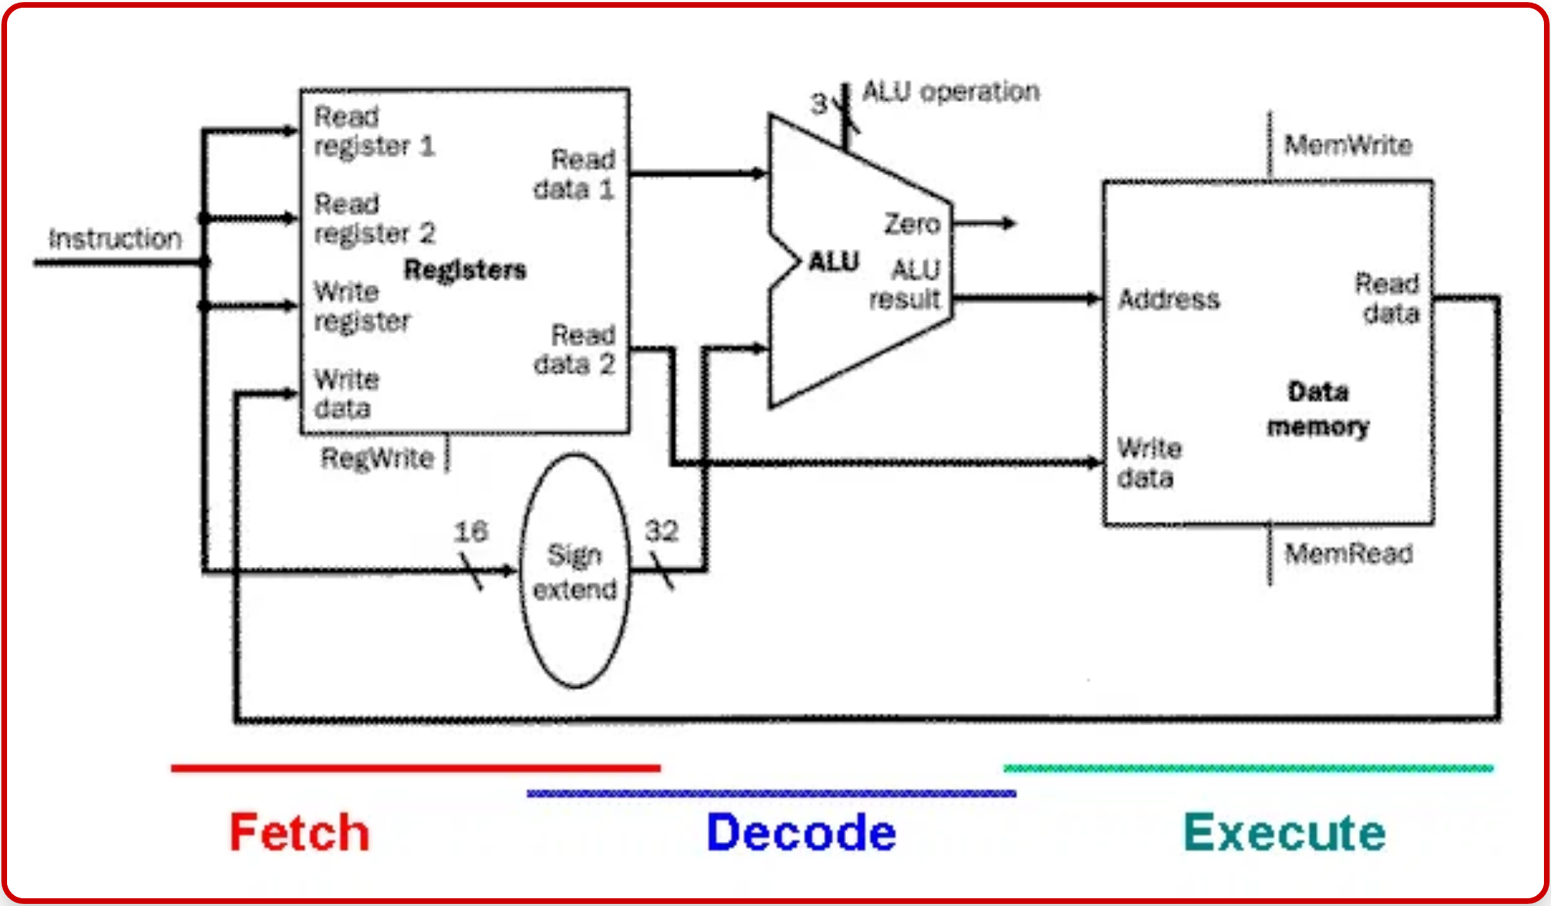
Challenges Overcome
Timing Violations
: Critical path delays exceeding clock period
constraints
Solution:
Optimized critical paths by reducing logic depth, registering
intermediate results, and implementing proper pipelining techniques
Latch Prevention
: Unintended latches being inferred by the
synthesis tool
Solution:
Ensured all signals were assigned values in all code paths,
used default cases in case statements, and properly initialized all
registers
Memory System Debugging
: Address decoding issues and data
corruption
Solution:
Implemented memory access state machine with proper
timing, added address validation logic, and created memory test
patterns for verification
Hardware-Software Integration
: Aligning instruction set with
compiler output
Solution:
Developed custom assembler to translate human-readable
assembly into machine code compatible with the CPU's instruction
format

Slide 9



Lessons Learned
Computer Architecture
Verilog Best Practices
Deep understanding of CPU components
and how they interact
Synchronous design principles
are crucial for reliable hardware
in real-time
operation
Appreciation for the
elegance of simple instruction sets
and
Proper state machine coding
prevents timing issues and
how they can accomplish complex tasks
unexpected behavior
FPGA Design Constraints
Hardware vs. Software Debugging
Timing constraints
are not just theoretical concerns but practical
Limited visibility
limitations
approaches
into internal states requires creative debugging
Resource utilization
requires careful planning and optimization
Physical constraints
like power, heat, and signal integrity affect
system behavior

Slide 10

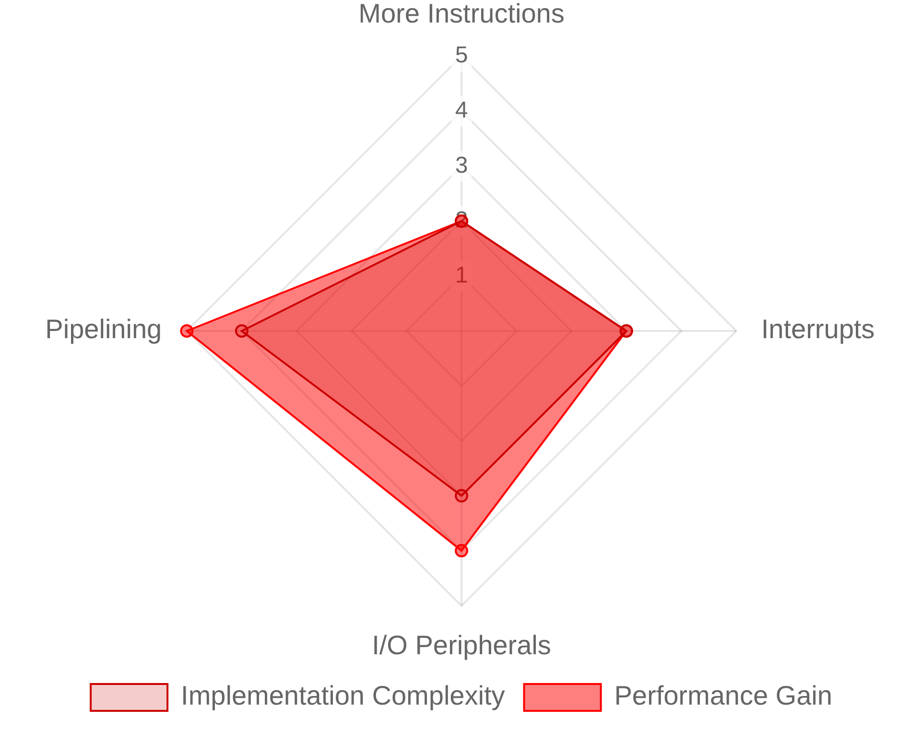



Future Enhancements
Add More Instructions
Expand the instruction set beyond the basic 16 instructions to include more complex operations like multiplication, division, bit shifting, and stack operations. This would enable more sophisticated programs and algorithms.
Estimated Complexity vs. Performance Gain
Implement Interrupts
Add interrupt handling capabilities to respond to external events without constant polling. This would improve I/O responsiveness and enable real-time applications with the CPU.
Add I/O Peripherals
Integrate additional peripherals such as UART for serial communication, SPI/I2C interfaces for sensor connectivity, and PWM controllers for motor control, expanding the CPU's interaction capabilities.
Pipeline the Design
Implement instruction pipelining to execute multiple instructions simultaneously at different stages, significantly improving performance by increasing throughput and reducing instruction latency.

Slide 11





Thank You!
[Daksh vaishnav]
[dakshvaishnavx@outlook.com
+91 97543-67129
https://github.com/prormrxcn/8_bit_cpu
Questions?

